Slide 1

From Dough to Data: Insights into Pizza Sales
Name : Sanvi Ojha
Reg. No.: 12212400
Roll no.:50

Slide 2
Introduction
In today’s data-driven market, leveraging sales data is key to strategic decision-making. This project analyzes a year of pizza sales data to extract insights for optimizing operations and boosting revenue.
The objective of this project is to perform a comprehensive analysis of a year’s worth of pizza sales data to uncover critical insights such as peak sales hours, weekly and seasonal trends, best and worst selling pizzas, and revenue contributions from various pizza categories and sizes. By doing so, the analysis aims to help businesses understand their operational strengths and weaknesses and provide recommendations for improvement.

Slide 3
Objective
To uncover critical insights such as:
Peak sales hours and weekly trends
Best and worst-selling pizzas
Revenue contributions by pizza categories and sizes
Which category contributing most sales

Slide 4
Problem Statement
KPI’s Requirement
We need to analyze key performance indicators for the pizza sales data to gain insights for better business performance:
1.Total Revenue : The sum of the total price of all pizza order. SUM([Total Price])
2. Average Order Value : The average amount spent per order, calculated by dividing the total revenue by the total numbers of orders. [Total Revenue]/[Total Orders]
3.Total Pizzas sold: The sum of quantity of Pizzas sold. SUM([Quantity])
4.Total Orders: Total number of orders placed. COUNTD([Order Id])
5.Average Pizzas Per order : The average number of pizzas sold per order , calculated by dividing the total number of pizzas sold by the total number of orders. [Total pizza Sold]/[Total Orders]

Slide 5
Problem Statement
Charts Requirement
We would like to visualize various aspects of our pizza sales data to gain insights and understand key trends. We have identified the following requirements for creating charts:
1.Hourly trend for total Pizzas sold : Visualization : Stacked bar chart
Created a stacked bar chart that displays the hourly trend orders over a specific time period . This chart will help us identify any patterns or fluctuations in order volumes on an hourly basics.
2.Weekly Trend for Total orders: Visualization :Line chart
Created a line chart (also used area chart) that illustrates the weekly trend of total orders throughout the year. This Chart will allow us to identify peak weeks or periods of high order activity.
3. Percentage of sales by pizzas category: Visualization : Pie chart(Donut chart)
Created a pie chart that shows the distribution of sales across different pizza categories. This chart will provide insights into the popularity of various pizza categories and their contribution to overall sales.

Slide 6
Problem Statement
Charts Requirement
We would like to visualize various aspects of our pizza sales data to gain insights and understand key trends. We have identified the following requirements for creating charts:
4. Percentage of Sales by Pizza Size : Visualization : Custom slider chart
Created a slider chart that represents the percentage of sales attributed to different pizza sizes . This chart will help us understand customer preferences for pizza sales and their impact on sales.
5. Top pizzas sold by pizza Category : Visualization : Butterfly chart (using horizontal stacked bar)
Created a butterfly chart tha represents the total number of pizzas sold for each pizza category. This chart will allow us to compare the sales performance of different pizza categories.
6. Top & bottom 5 best sellers by Revenue , Total Quantity and Total Orders : Visualization : Bar chart Created a bar chart that shows the distribution of sales across different pizza categories. This chart will provide insights into the popularity of various pizza categories weather they are most popular or underperforming pizza.

Slide 7
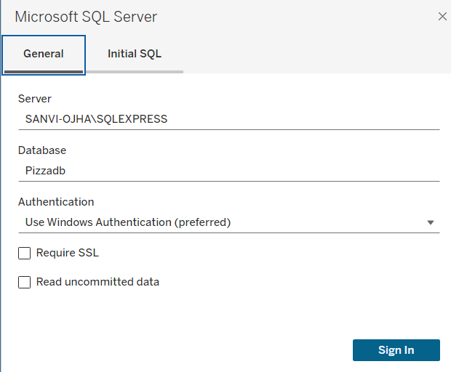
How I started ?
Downloaded SQL Management Server(SMS)
Downloaded Pizza_sales dataset
Observation -----
Total Records: 48620 rows.
File Format: CSV
Size: Around 12 MB
Imported dataset into SMS
Made database in SMS pizzadb
Performed SQL queries for validation of results in tableau.
Imported pizzadb in tableau through Microsoft SQL server.

Slide 8
In data sources changed short form words through edit aliases
In dashboard I made KPI(key performance indicator) for RealTime Data Analysis
Used slider for date
Used navigation for navigating to different dashboards
Used different types of chart for perfect visualization
Used worksheet filter for different charts
Used dual axis and value((0))==for proper calculation
Used images for enhancing dashboard also imported image in main (C:\Program Files\Tableau\Tableau 2024.2\defaults\Shapes\Rounded Rectangle)
Format all the visualization values
synchronization of axes
formatting numbers

Slide 9
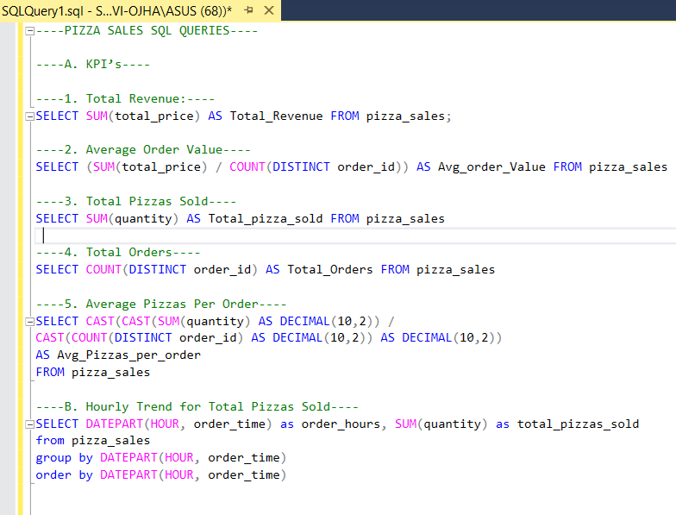
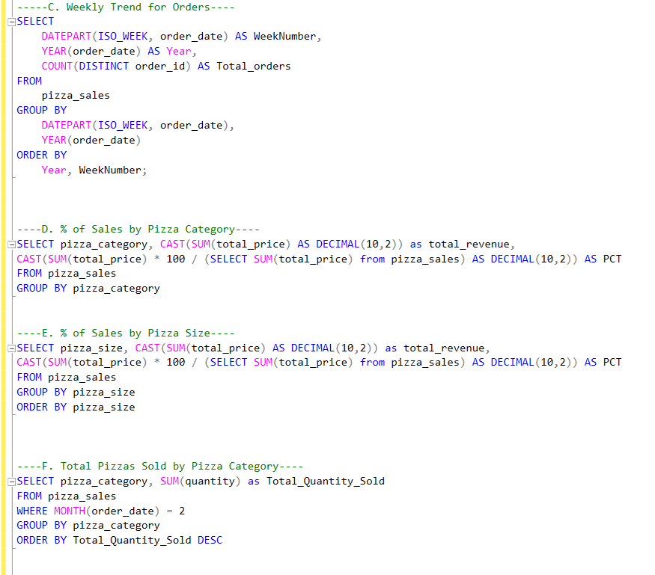
Screenshots

Slide 10
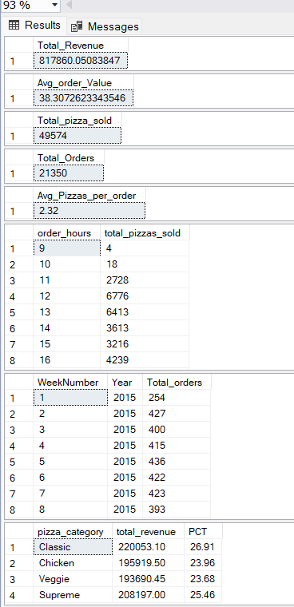
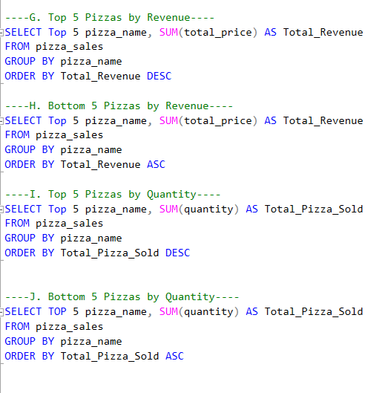
Screenshots

Slide 11
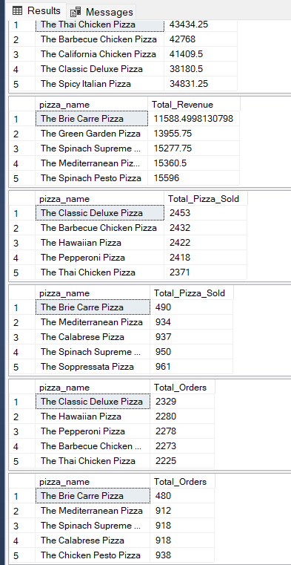
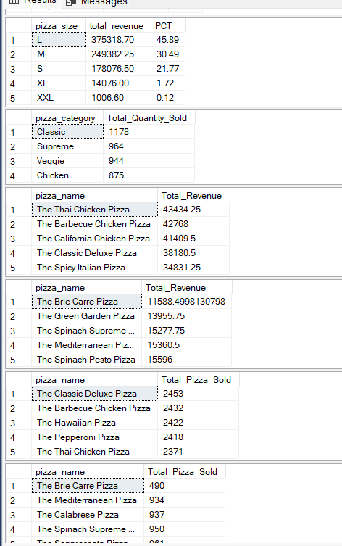
Screenshots

Slide 12
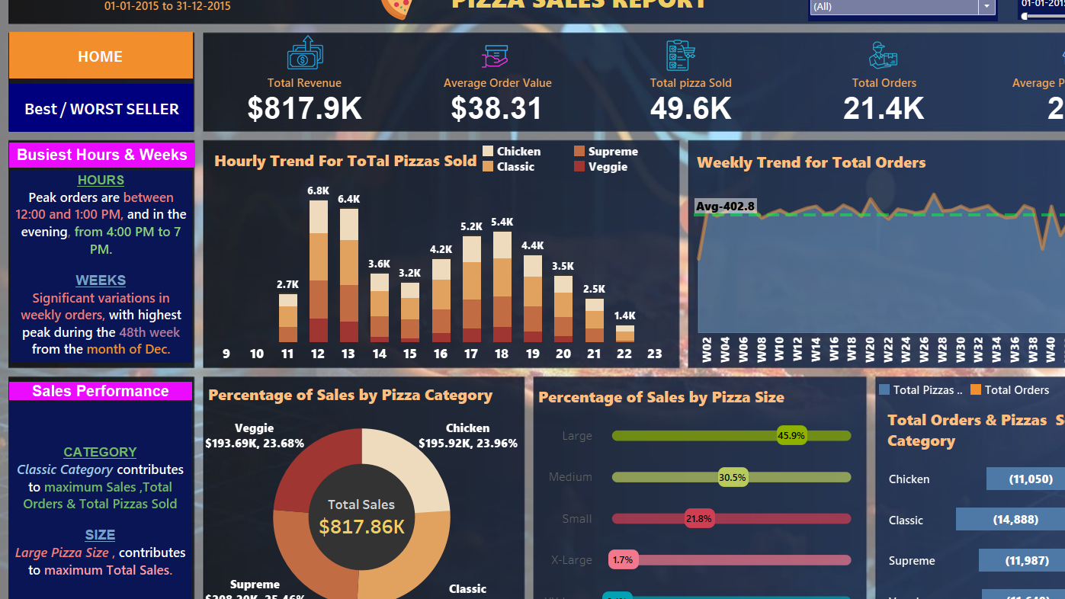
Screenshots

Slide 13
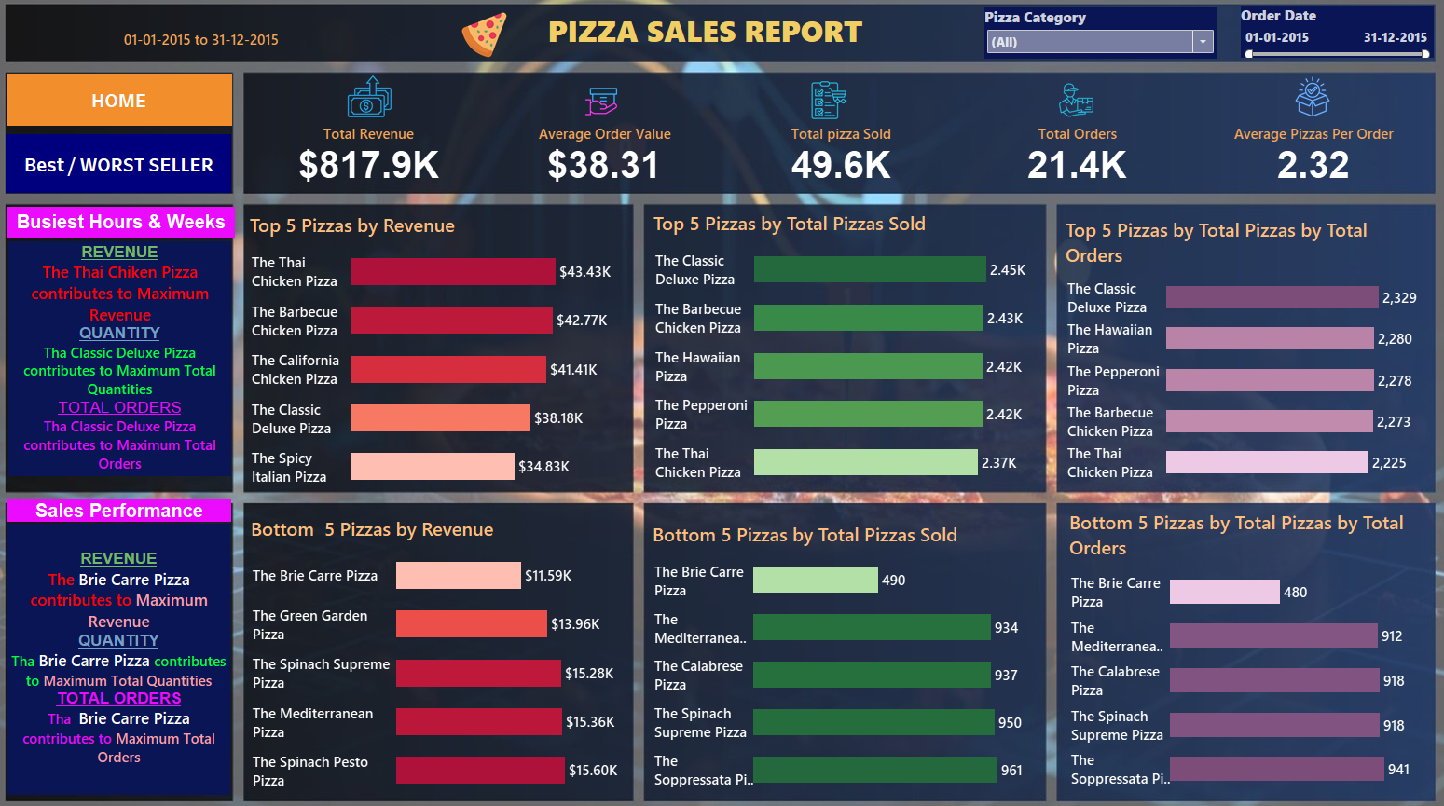
Screenshots

Slide 14
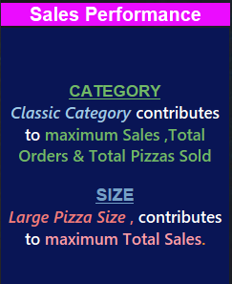
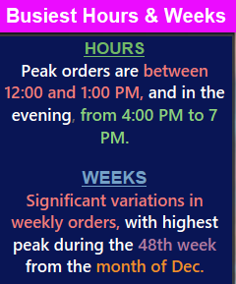
Result of analysis

Slide 15
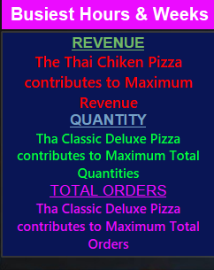
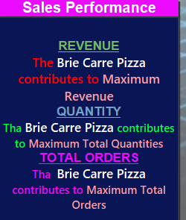
Result of analysis

Slide 16

Thank you

